Slide 1
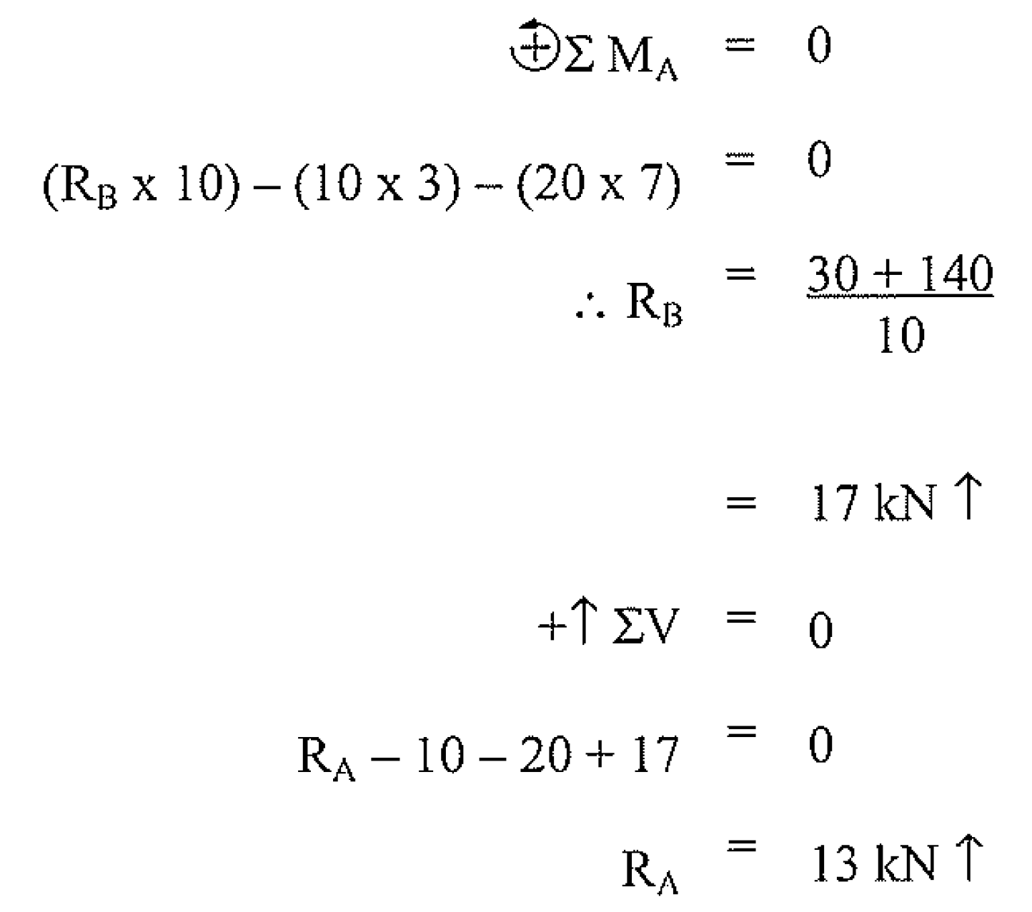
The shear force at any particular point is calculated by adding all the force components acting perpendicular to the member's axis to one side of that point.
If the right side tends to move down relative to the left side, it is considered to have positive shear. Figure 2.35 illustrates the sign convention used in constructing shear force diagrams.
A shear force diagram is constructed by plotting the shear force values for all points along the beam.
Examine the method used to draw a shear force diagram for a simple 10 m beam loaded with a 10 kN force and a 20 kN force, each 3m from either end of the beam. See Figure 2.36
First, you would find the reactions.

Slide 2
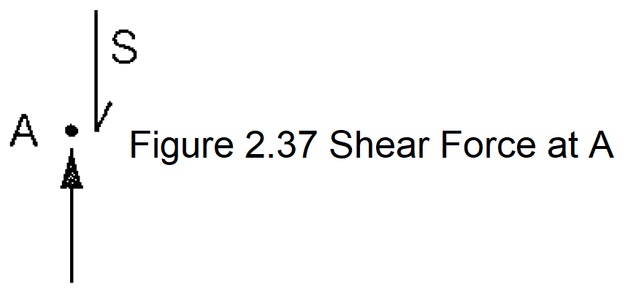
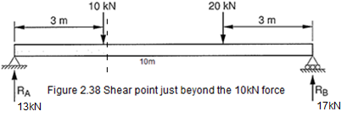
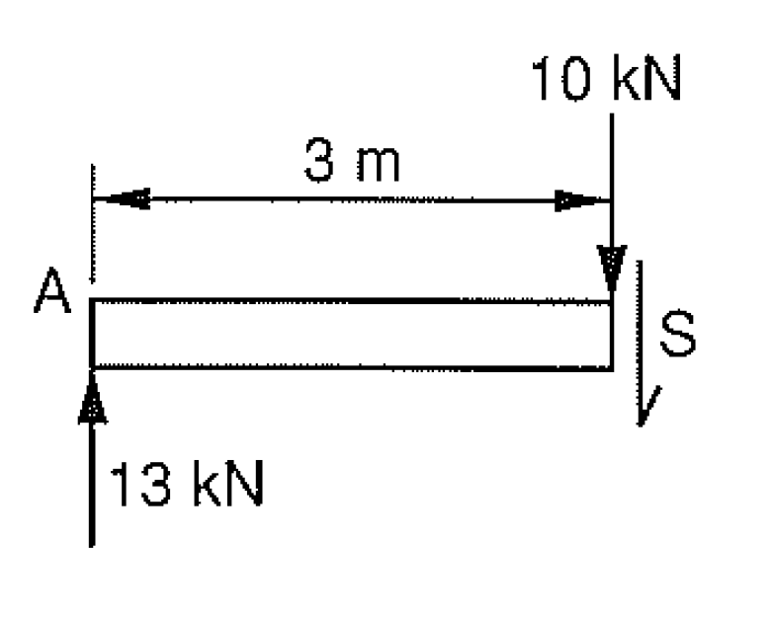
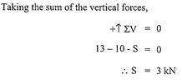
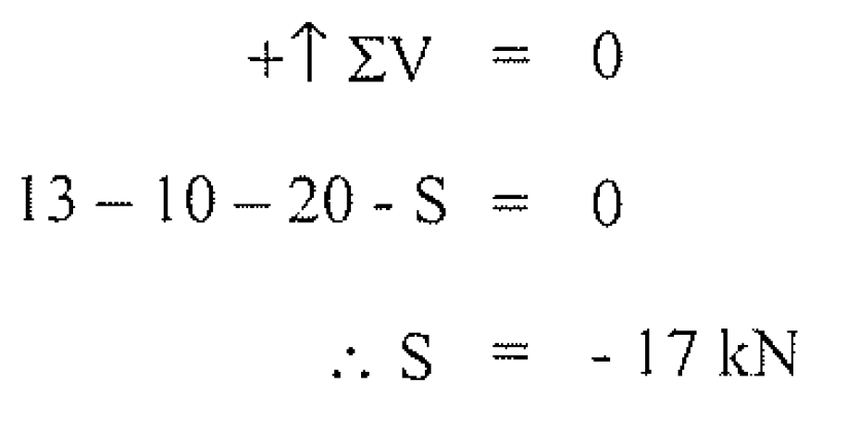
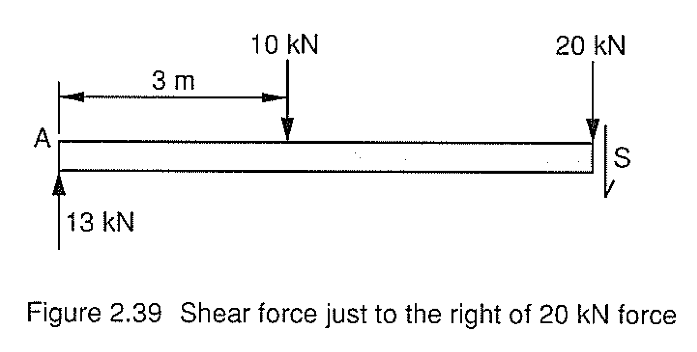
To find the shear force just to the right of A, consider just the very left part of the beam as shown in figure 2.36, and calculate the sum of the vertical forces.
Now consider a 3m length of the beam from the left support to just beyond the 10 kN force, as shown in figure 2.38.
Moving across to the 20kN load, we have

Slide 3
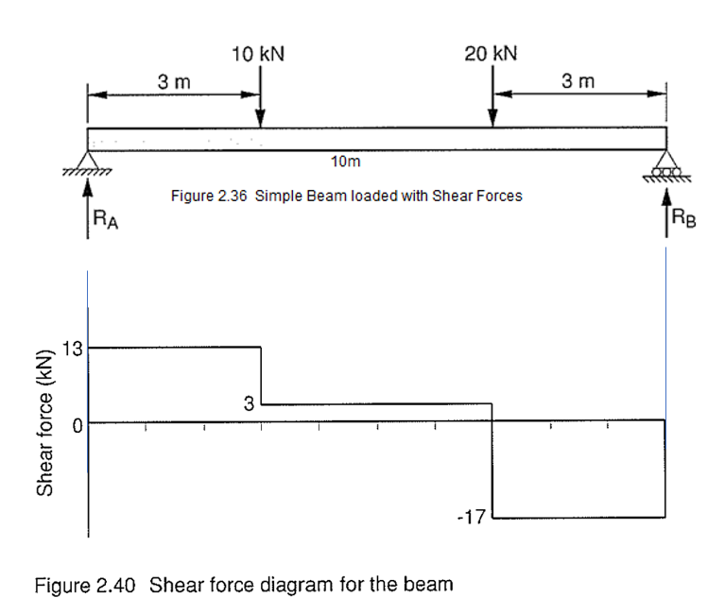
The shear force diagram (SFD) for the beam is now drawn to scale. From the diagram a value for the shear force can be determined at any point along the beam.
Note that the shear force does not change between concentrated point loads, and this is represented by a horizontal line.
An easy method to construct a shear force diagram is called 'follow the force rule'. The shear force will remain constant until it reaches a concentrated point load. It will then change by the amount of the force in the same direction as the force.

Slide 4
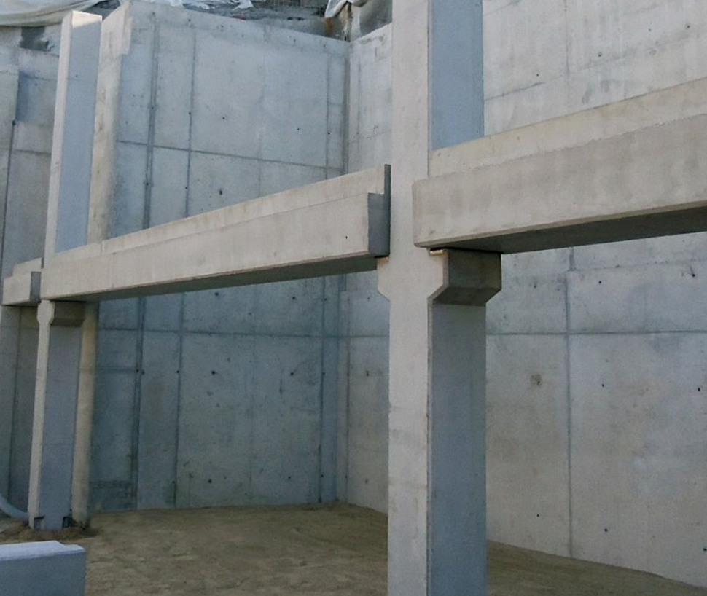
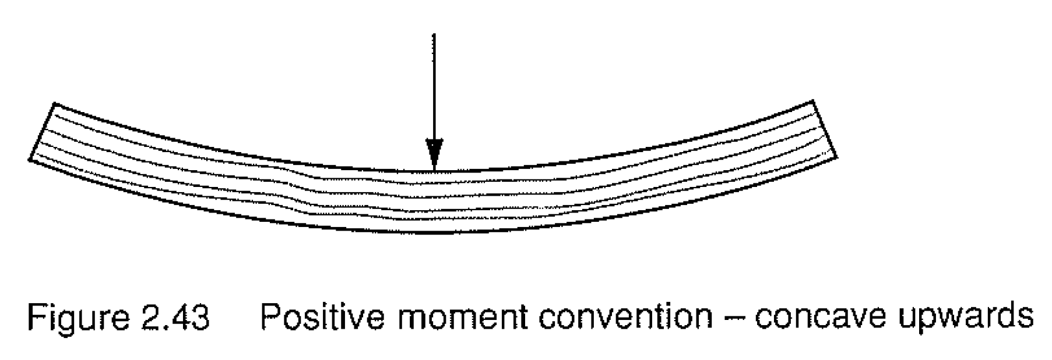
Bending Moments
Beams are commonly used in buildings to support loads over a variety of spans in preference to a triangulated truss. Trusses tend to use up too much space.
The beam will have been designed so as not to fail due to shear. However, the loads will also induce some bending of the beam over the span. The beam will have to be designed by the engineer to withstand any bending moment.
As with shear forces, the bending moment is calculated by adding all the bending moments to one side of any particular point. It is the amount of moment that needs to be added to the beam to balance all the bending moments to one side.
As with shear forces, a sign convention is used for bending moments. A beam that bends down in the middle when a load is applied is regarded as being in positive bending.

Slide 5
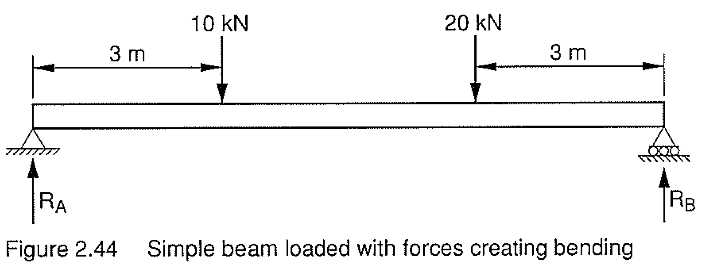
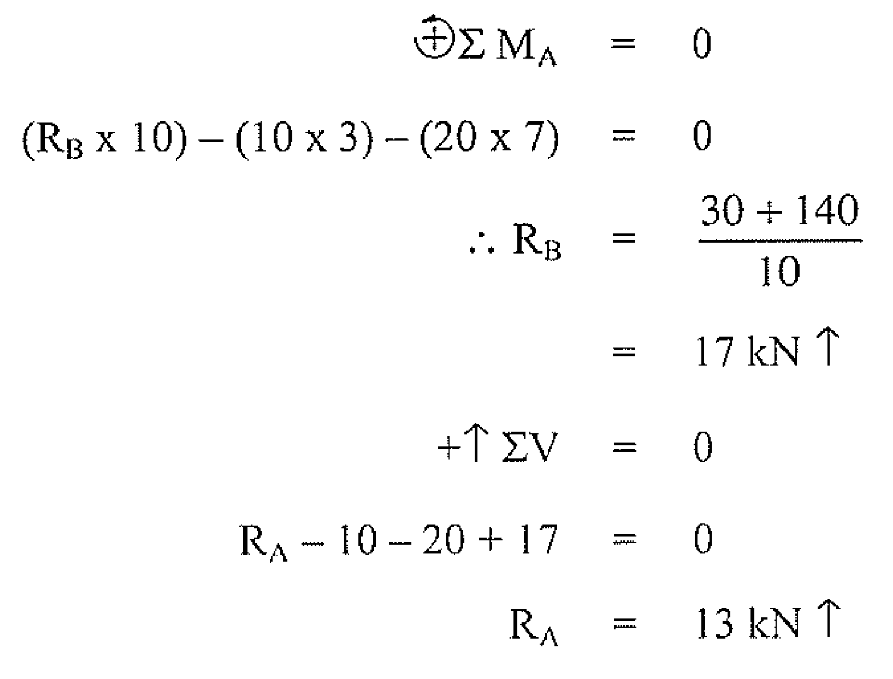
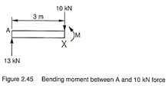
Examine the method used to draw the bending moment diagram for a simple 10m beam loaded with a 10kN force and a 20kN force, 3m from each end of the beam, as shown in figure 2.44.
First, you would find the reactions
Bending moment to the right of A about the point X, 3m from A but not including the10kN force.

Slide 6
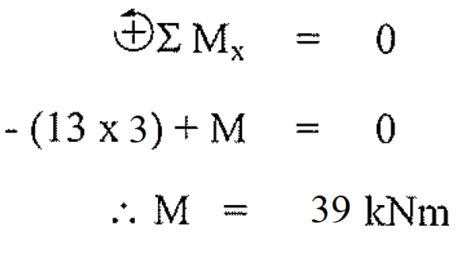
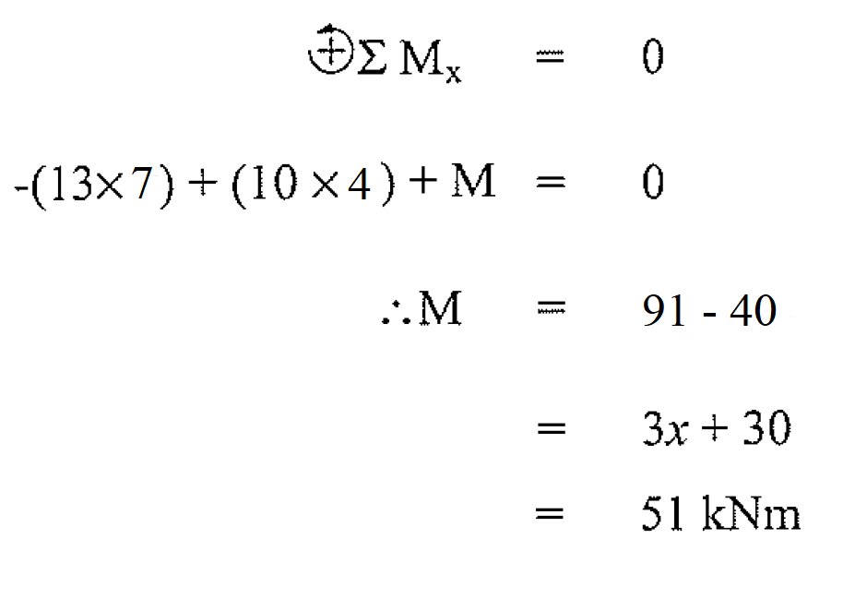
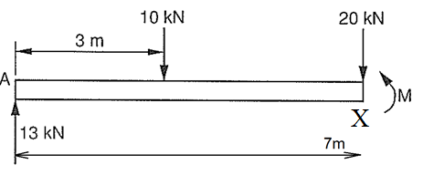
Take moments about the 3m position to the right of A but not including the 10kN force.
Take moments about the 7m position to the right of A but not including the 20kN force

Slide 7
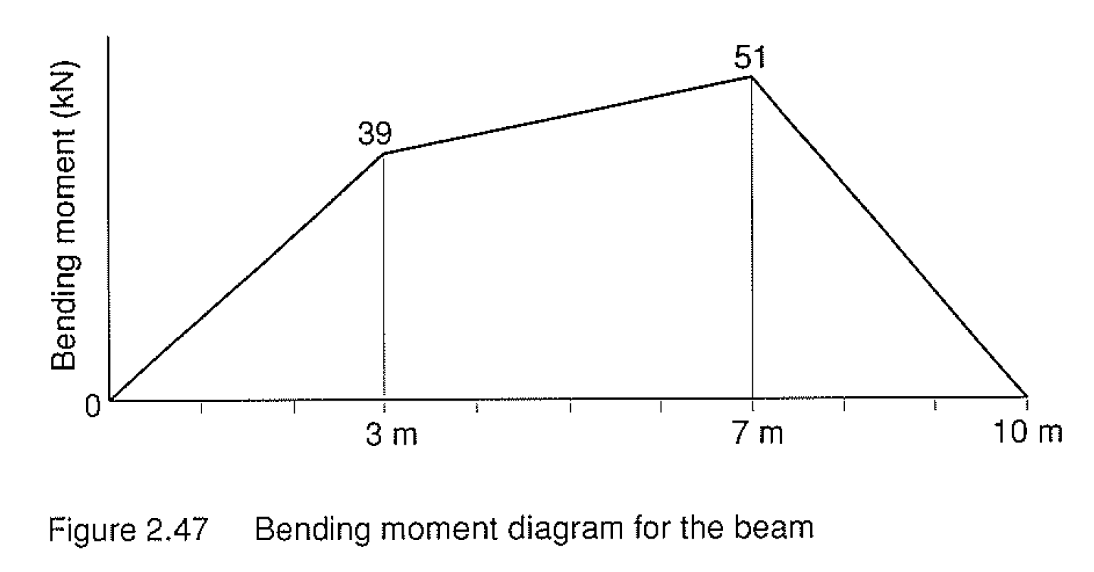
Take moments about the 10m position to the right of A (at RB) but not including the Reaction RB force
The bending moment diagram for the beam is now drawn to scale. From the diagram a value for the bending moment can be determined at any point along the beam.

Slide 8
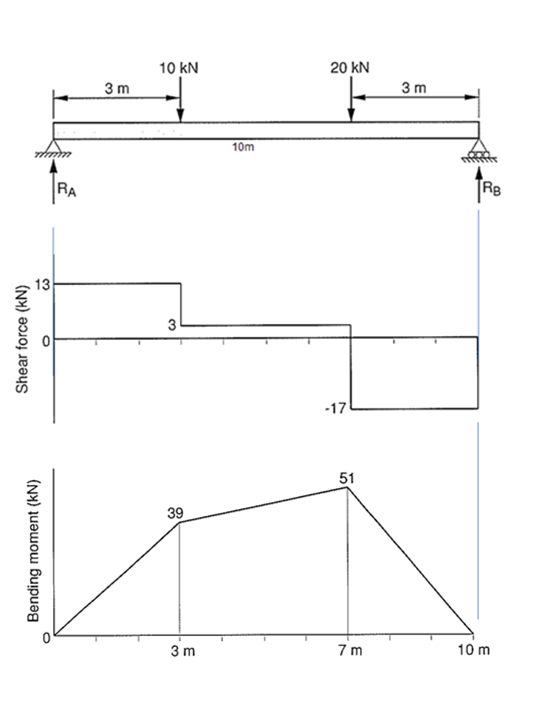
Combining the diagrams
What is the relationship between SF = 0 and BM?

Slide 9
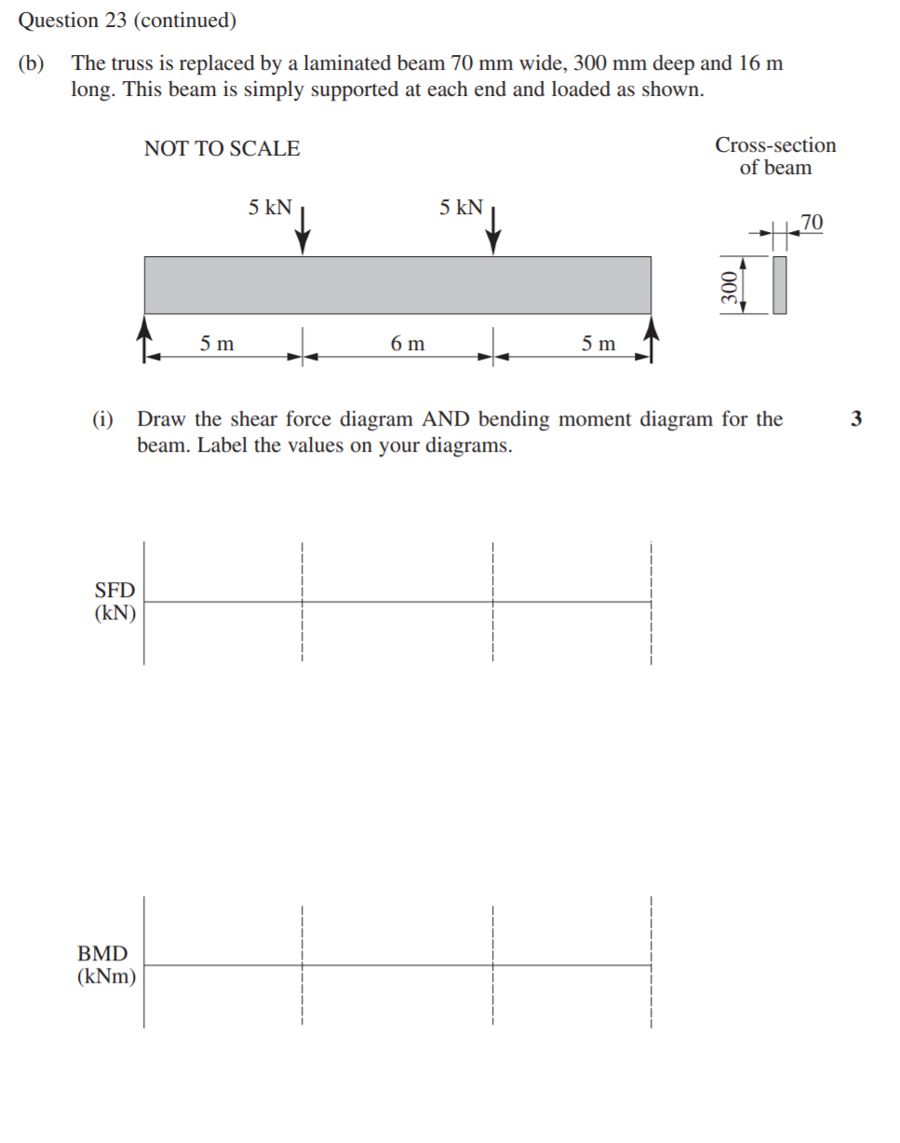
Previous HSC Questions
2013

Slide 10
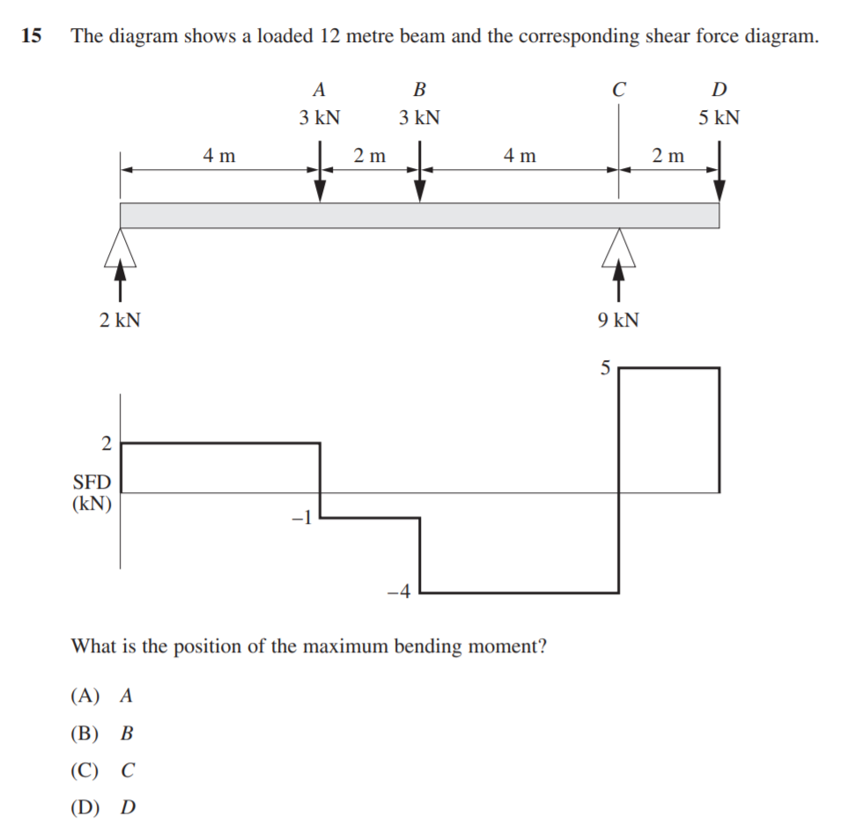
2014

Slide 11
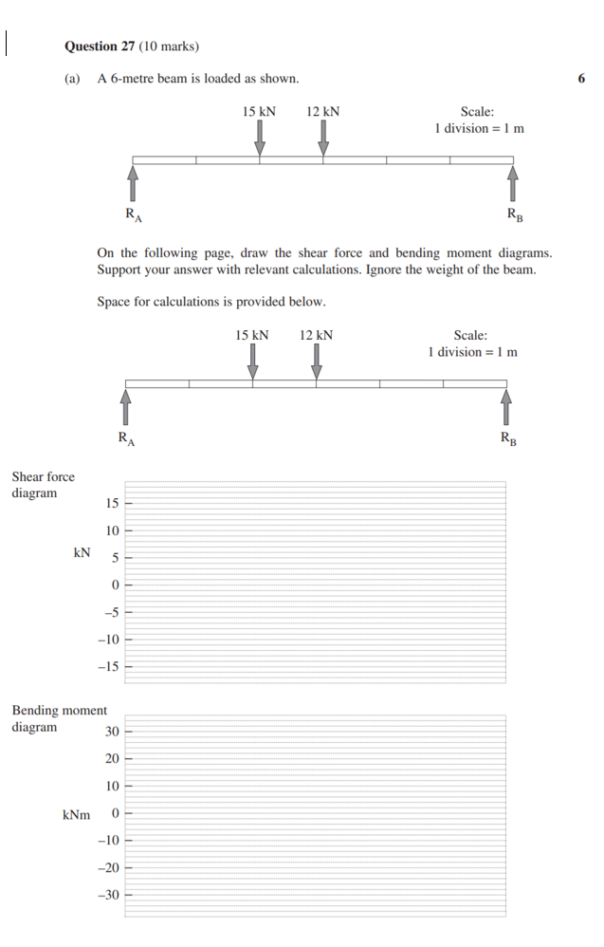
2018

Slide 12
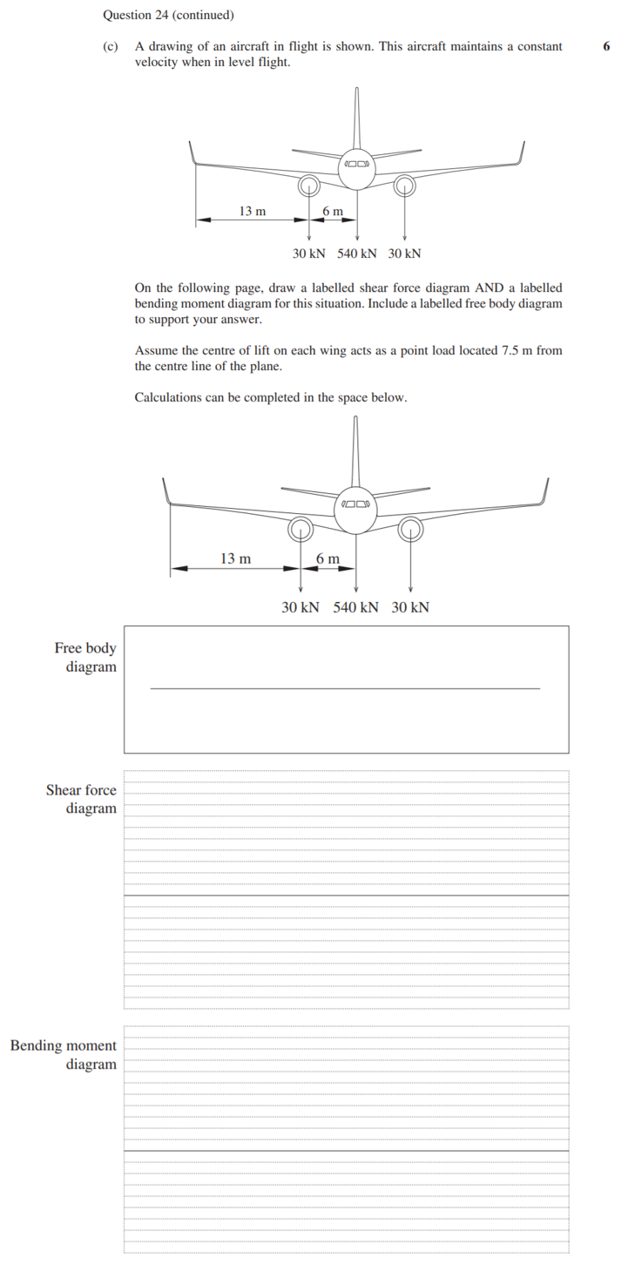
2019

