Slide 1
Tips for tackling assembly drawings in the HSC
Yr 12 Engineering Studies

Slide 2
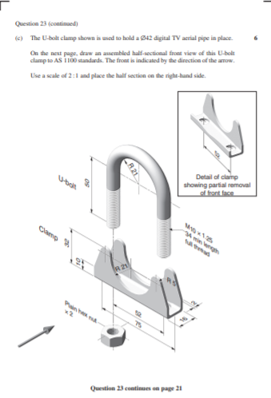
Assembly Drawings -
2017 HSC – Question 23
Step 1 – Begin by analsing the question to clearly identify some of the knowledge and skills examiners will be looking for in your response.
The U-bolt clamp shown is used to hold a Ø42 digital TV aerial pipe in place. On the next page, draw an assembled half-sectional front view of this U-bolt clamp to AS1100 standards.
The front is indicated by the direction of the arrow. Use a scale of 2 : 1 and place the half section on the right-hand side.
Half-section; make sure that you only section half of the front view and it is specified that this should the right hand side that appears in section
AS1100 standards; make sure to apply appropriate standards to your drawing; in this example you need to check standards for sectional views, external threads and nuts as well as following appropriate standards for orthogonal drawings (position of views, line types etc)
Scale 2:1; double size

Slide 3
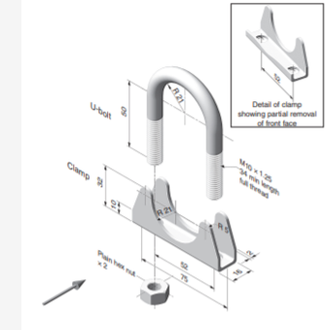
Assembly Drawings -
2017 HSC – Question 23
Step 2 – analyse the drawing carefully noting all important dimensions and notes supplied
Detail drawing showing spacing for holes
Thread information including MajorФ and thread length
Nut information; note little things such as x2. Must show two nuts in position
Arrow indicating direction of viewing for front view. Note in this example that is also indicating view will be sectioned

Slide 4
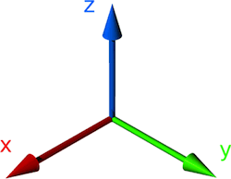
Assembly Drawings
2017 HSC – Question 23
Step 3 – look at how the components align, thinking about how they would slide together when compressed along x, y and/or z axis
Look for common dimensions which indicate placement of components

Slide 5
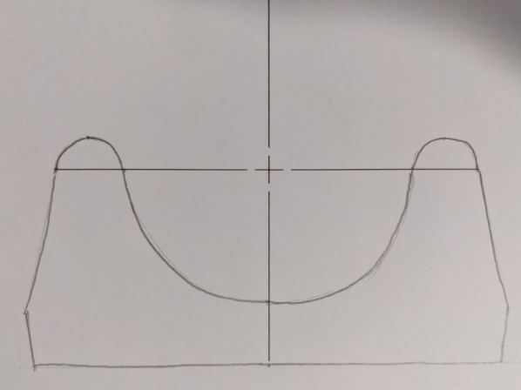
Assembly Drawings – Step by Step
Draw first major component paying attention to sizes and scale.
Note: simple drawing instruments such as a compass, set squares and eraser will help with the presentation and accuracy of your drawing. Make sure you have ALL necessary equipment with you on the day of the exam.
However in the case of being rushed for time a quick sketch will enable you to demonstrate understanding of key concepts.

Slide 6
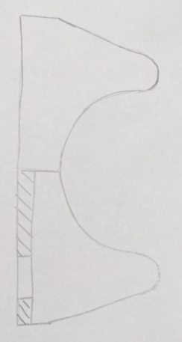
Assembly Drawings – Step by Step
Apply sectioning where appropriate.
You are now building your marks as you demonstrate your understanding of concepts such as sectional views.

Slide 7
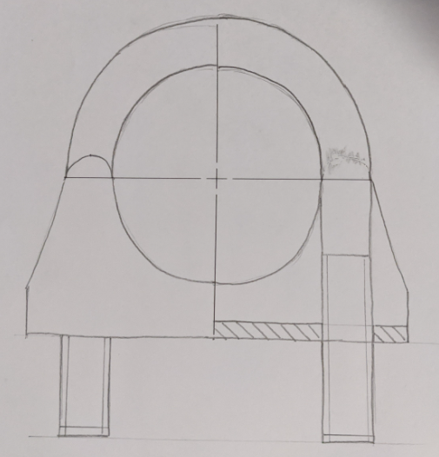
Assembly Drawings – Step by Step
Progressively add components and detail to your drawing. Take special care to note dimensions such as length of bolts, depth of holes etc to ensure correct placement and positioning.
Add detail such as threads as you go.
Further marks are gained as you demonstrate knowledge of thread representation.

Slide 8
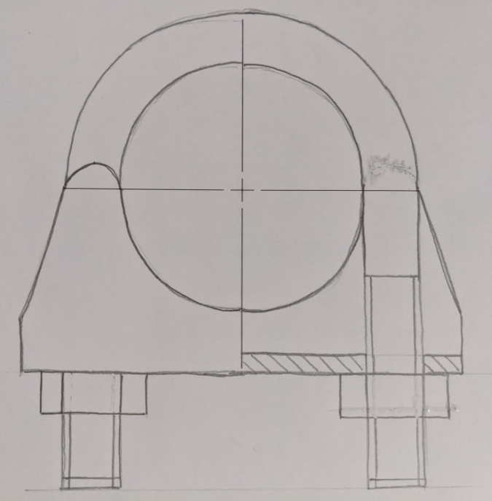
Assembly Drawings – Step by Step
Add final components and finalise your drawing by darkening outlines, erasing unnecessary lines etc.
Note: a good quality sketch can earn you the same or close to the same marks as a drawing done with instruments but can take a fraction of the time

Slide 9
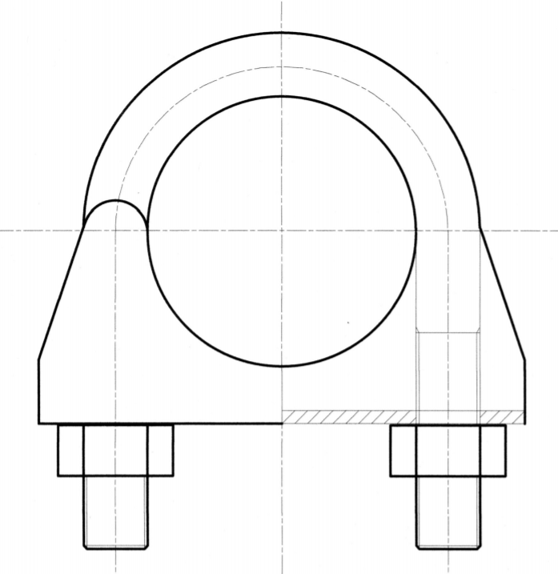
Assembly Drawings
Do not section bolts, shafts etc
2017 HSC – Question 23
Annotated Solution
Centre Lines
Correct Assembly
Note: Each time you address one of these you are giving yourself the opportunity to gain marks
Only right hand side sectioned
External thread
Hatching of cut surfaces
Correct representation of nuts using AS1100 to determine sizes
Application of scale 2:1 – drawn to double specified dimensions

Slide 10
Assembly Drawings
2017 HSC – Question 23
Marking Guidelines
Note:
6 mark value which means you have the opportunity to gain marks for partial solution which demonstrates understanding of key elements such as:
Sectioning
Thread Representation
Nut Representation
Centre lines
Partial assembly
Remember – the more you demonstrate the closer you get to full marks

