Slide 1
Sampling and quantisation
Year 12 Engineering Studies - Telecommunications

Slide 2
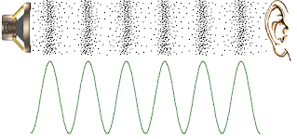
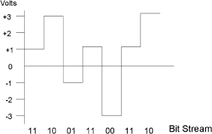
Analogue and Digital Signals
Analogue Signals – constantly changing values (amplitude)
Sinusoidal Wave Form
Digital Signals Signals – fixed values (binary 0 & 1, ternary 0, 1 & 2, quaternary 0,1,2 &3)
Square Wave Form

Slide 3
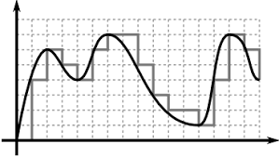
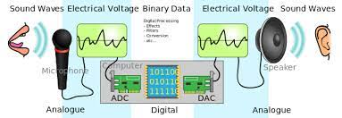
Converting Analogue to Digital

Slide 4
Converting Analogue to Digital
Recording temperature over a 24 hour period could be graphed as illustrated.
This replicates an analogue signal wth temperature readings constantly changing incrementally.
What was the temperature at 1:40pm?

Slide 5
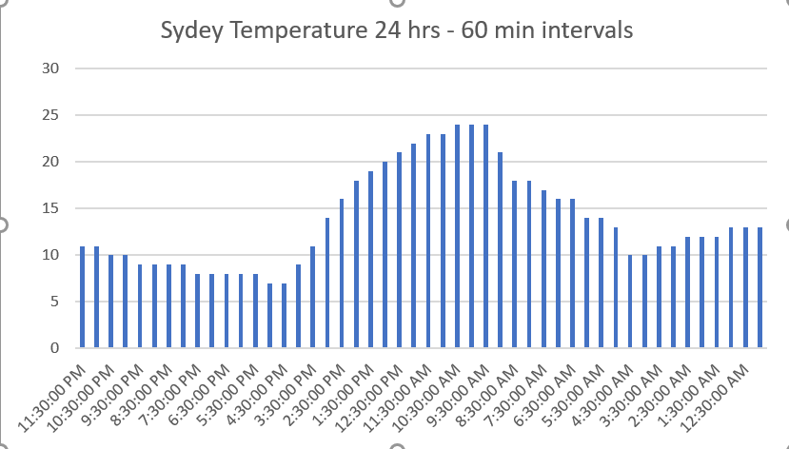
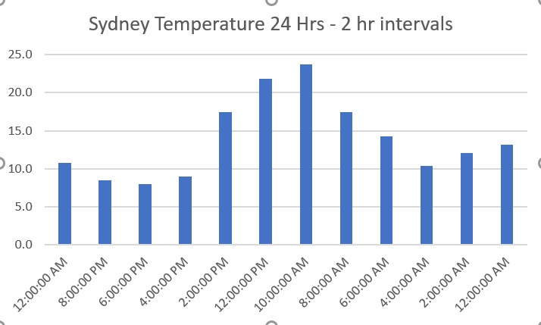
Converting Analogue to Digital - Sampling
Sampling – measuring at set intervals
When we sample we can start to move to a square wave where small changes in between the sampling points are not recorded.
By decreasing the sampling rate we reduce the amount of information recorded but loose detail.
What was the temperature at 1:40pm?

Slide 6
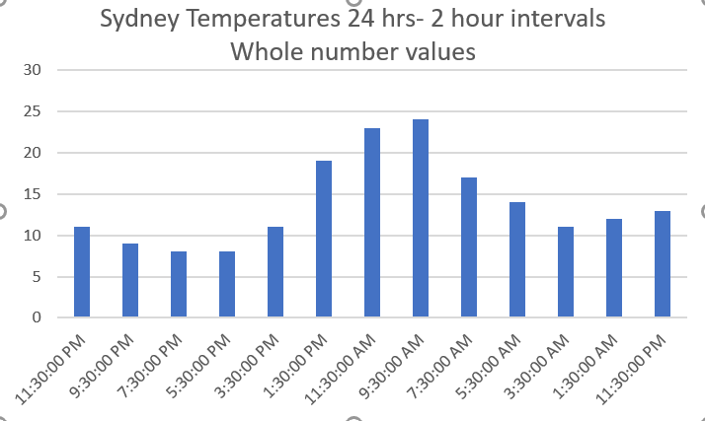
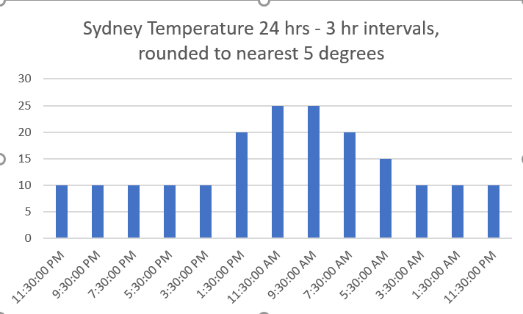
Converting Analogue to Digital - Quantisation
Quantisation is the rounding of recorded values up or down to the nearest digital value.
What was the temperature at 1:40pm?

Slide 7
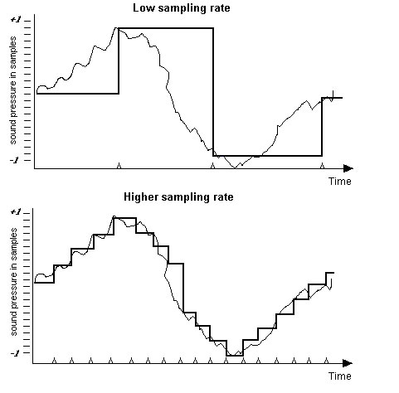
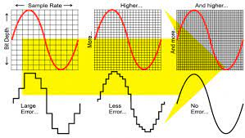
Effect of sampling rate and quantisation on sound quality

Slide 8
Effect of sampling rate and quantisation on sound quality
https://youtu.be/zC5KFnSUPNo

