Slide 1
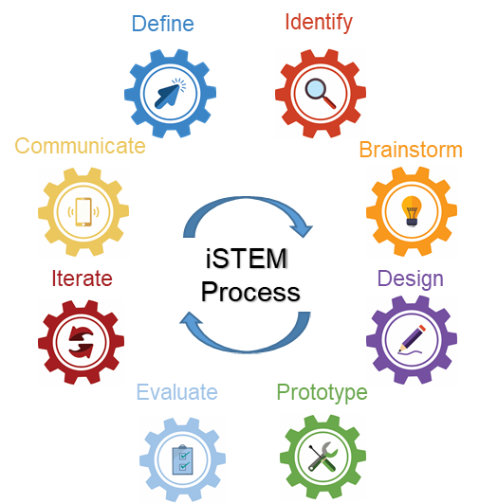
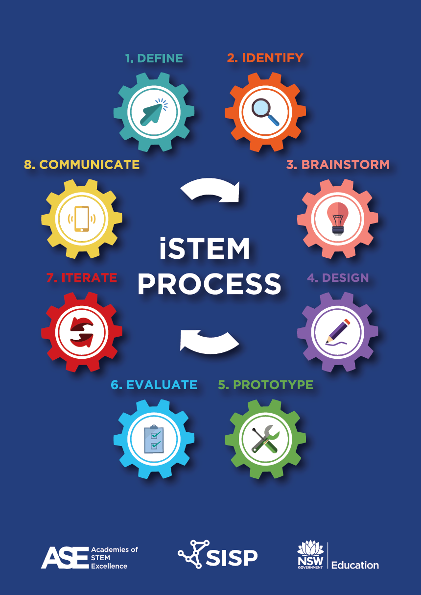
iSTEM ENGINEERING DESIGN PROCESS

Slide 2
8 STAGES OF THE iSTEM PROCESS
 | 1. Define – the problem
 | 2. Identify – the constraints
 | 3. Brainstorm – possible solutions
 | 4. Design – your solution
 | 5. Prototype – your solution
 | 6. Evaluate – your solution
 | 7. Iterate – your solution
 | 8. Communicate – your solution
Define
Identify
Define
Communicate
Brainstorm
Identify
iSTEM
Process
Brainstorm
Iterate
Design
Communicate
Design
Evaluate
Prototype
Iterate
Prototype
Evaluate

Slide 3
1. Define The Problem Describe the problem or need in detail to gain understanding. Think about and discuss initial thoughts.
Key Questions
Possible Actions
Why does the problem need to be resolved?
What experiences can you relate to the problem?
What caused the issue to begin with?
What are your initial thoughts of how you could possibly resolve the issue?
How can you help contribute to the solution?
Do you have more questions about the problem?
Who would benefit from finding a result?
What process will need to occur to achieve the end result?
Where do you start to resolve the problem?
Mind map initial thoughts and additional questions
Generate discussion about prior knowledge and experience
Collaborative discussion on what assets are available
Discuss resources available/needed to assist
Define the actual problem clearly and concisely
Identify sources of information
Articulate the scope and nature of the problem
Produce a statement of the problem

Slide 4
2. Identify The Constraints Outline the specific boundaries for which the project will be confined.
Key Questions
Possible Actions
How much will it cost and overall budget?
What knowledge will be required to solve the problem?
What skills are needed?
Time for completion?
Tools and equipment required and available?
Scope of the final task?
What data or information is required?
What are the aesthetic, functional and ergonomic considerations?
What are the features that must be included within the solution?
Have all limitations been identified?
Research constraints
Meet with client to determine customer needs
List all relevant constraints
Produce a high level budget plan
Produce a resource list, including tools, materials and people
Identify start and finish dates for the project
Identify what data and information will need to be collected
Research the problem and potential solutions
Produce matrix identifying the aesthetic, functional, ergonomic consideration

Slide 5
3. Brainstorm Multiple Solutions Discuss, expand and scaffold ideas collaboratively.
Key Questions
Possible Actions
Expand on initial understanding ‘Define’ ideas and ‘Constraint’ categories
What categories are relevant to research?
Identify and analyse data and additional information needed to build knowledge?
What are existing solutions and thoughts of improved solutions?
Expand priorities and constraints that must be included within the solution
How will skills be implemented?
How can technology be applied?
Are the opportunities to reflect on quality and application throughout the process?
Use a range of brainstorming techniques to produce ideas on developing solutions
Produce a range of thumbnail sketches and annotated drawings
Combine ideas to create new ideas
Research existing solutions and design ideas
Complete a skills audit
Research possible technologies and techniques
Add to mind map ideas
Attempt to refine and simplify ideas relevant to ‘Design’
Expand on knowledge and solutions, take most relevant ideas to research

Slide 6
4. Design The Most Promising Solution Investigate areas which can provide a variety of options. Refine ideas down to one viable solution, create a plan to communicate ideas and process to resolve the problem.
Key Questions
Possible Actions
What the final product will be - concept/prototype/functional product/presentation/research task?
What existing solutions can be evaluated?
Refine and investigate key categories from ‘brainstorm’
What is the planned direction and priorities?
Has a budget been considered?
What technological skills are needed?
What materials are available or needed for the task?
What tools and skills are needed to complete the task?
Are sizes, ergonomics, aesthetics a consideration?
What skills are available or needed to ensure success?
Estimated timeline and actions for management
Identify priorities and goals to ‘Prototype’ the task
Timeline of project to completion and/or process checklist
Outline and allocate roles and responsibilities
Analyse potential solutions and refine ideas
Establish baseline data
Identify resources available/needed to assist
Define the ‘best possible solution’ to ‘Prototype’
Refer to ‘brainstormed’ ideas and provide scaffolding and regular feedback
Produce detailed drawings of solutions/algorithms, flowcharts

Slide 7
5. Prototype Your Solution Produce a model of the best possible solution from ‘Design’ stage. This stage may call for areas within the plan to be revised.
Key Questions
Possible Actions
Do you have an adequate plan in place and are you prepared to begin the creation phase?
Do all stakeholders know their roles and responsibilities?
Can the final choices be justified?
What type of prototype: product, mathematical, computer.
Are there opportunities to reflect on quality?
Is time management being effectively applied?
WHS processes for practical tasks?
Are resources available to execute the task effectively? Technology/materials/skills.
What processes will need to be evaluated?
What testing of the prototype is going to be required?
Execution of areas identified to be completed
Use rapid prototyping techniques to produce models of potential solutions
Produce working models that demonstrate the aesthetics, functions and ergonomic attributes of the potential final solution
Provide regular feedback to clients on progress
Test each model against working criteria and goals
Test for functionality and performance
Compare and evaluate results from testing to determine which, if any, of the possible solutions will be implemented.
If none of the solutions are ideal, return to stage 3 or 4

Slide 8
6. Evaluate And Test Your Solution Evaluate the solution against the identified problem in ‘Define’.
Key Questions
Possible Actions
Was the plan followed?
Has the solution resolved the problem as defined?
Does it resolve the problem?
Where can revisions/improvements be made?
Will the revisions significantly improve the solution?
How long will it take for the revisions to be made?
Will the revisions be costly either time or financially?
Are there resources available to achieve improvements?
Is there more research and testing required?
Where could improvements be made in the earlier stages?
Critically reflect and evaluate the solution to the initial problem, plan and baseline data
Client evaluations and feedback to establish if the solution is successful
Self reflection from the design team to evaluate the process and improvements to be made
Plan revisions if they are needed for the final product
Plan improvements for the final solution
Design team to provide regular feedback to client
Re-evaluate, investigate, test and brainstorm until the solution resolves the problem effectively
Update detailed drawings required for the production of the final product

Slide 9
7. Iterate To Improve Your Solution Evaluate the solution against the identified problem in ‘Define’. Produce solution, revise and continually improve. May require starting back at earlier phases.
Key Questions
Possible Actions
How can the solution still meet the identified need?
Has the identified problem changed?
Are there other opportunities?
How can the solution be improved?
What are the consequences of not iterating?
Do we need to revisit earlier phases of the process?
What will the revisions look like? Are there plans?
What needs to be completed?
What are the priorities?
How much time is needed to manage the revisions?
Will the revisions remain within the budget?
What new skills or additional resources will be required?
Refine ideas based on results of experimentation and testing
Prototype the final product, system or environment?
Redesign solution, moving back through the process if required
Analysis in reference to plan and baseline data
Continual cycle from ‘Design, Prototype and Evaluate’ until the ‘best possible solution’ is found
React to the results of evaluation
All key stakeholders should agree on the proposed product, system or environment.
Produce the final product? Minimal Viable Product level or production level

Slide 10
8. Communicate And Share Your Solution Share and communicate the solution.
Key Questions
Possible Actions
Have all key stakeholders been informed throughout the process?
Who do you need to share the solution with?
Would it benefit the broader market?
How can you share the solution effectively?
Have all the product specifications been documented?
Have you received all regulatory approvals?
Have all necessary reports been provided?
What are the results of product testing?
Pitch the solution to client or potential investors
Document the design specifications, measurements and communicate to all groups
Communicate between key stakeholders in meetings, presentations, reports and drawings
Develop a communications and marketing plan
Seek all necessary regulatory and legal approvals
Ensure all Intellectual Property is protected
Provide all necessary materials to the manufacturer or developer for full production of the product, system or environment

